Slide 1


Cancer survival analysis using population-based data Granada, 27-28 March 2017
Age-standardised Net Survival
&
Cohort and Period Net Survival Estimates

Slide 2
Outline
Age-standardised Net Survival.
Cohort and Period Estimation of Age-standardised Net Survival.
Practical implementation.
Notes:
Time until an event occurs, not just the proportion of patients who survived

Slide 3
Introduction
Net Survival deals with Competing Risk.
Pohar Perme...to deal with censoring (IPCW): because the probability of death is increased for the majority of cancer sites during the first years of follow-up.
OK, great. But …
The excess risk of death from cancer is itself often dependent from the structure of AGE of the Background POPULATION.
Notes:
So we want to adjust for age in our comparisons of cancer survival. As we saw earlier in the course, net survival adjusts for the background risk of death in the population the patient was drawn from. Next lecture Devon will talk more about lifetables, but in general we assume we’ve removed any hazard due to the background age-specific population hazard for patients we’re comparing. But age is still a problem in our comparison.
This is because cancer hazard itself changes with age. Older patients have co-morbidities and other barriers to early diagnosis and optimal treatment, meaning a cancer diagnosis for them holds more hazard than for younger patients. Adjusting for expected background mortality in the population doesn’t account for this, and so differences in distributions of patient age at diagnosis are still playing an important role in net survival comparisons.

Slide 4
Why Age-Standardised Net Survival?
So, the Comparison of all-ages survival between two or more populations (regions or countries), or when analysing survival trends over time can be misleading if the age structure of the cancer patient populations is very different.
Imaging a Net Survival comparison between JAPAN and GUATEMALA
We need to control for the different STRUCTURE OF AGE when comparing
Net Survival between populations
Notes:
To deal with this we can do survival comparisons only for specific age groups, say compare only patients aged 70-80, 60-70, etc separately. This addresses the impact of age, but it’s inconvenient not to have a summary measure of overall survival differences between populations. The solution to this is to produce a summary survival value composed of the survival estimates in each of the age-groups given certain weights adding up to 1 or 100%. This can statistic can then be compared between populations, so long as the same age-groupings and weights are used in the two populations – I’ll talk a bit later about the different possible weights and how to choose them. This approach is known as “direct age-standardisation”, and it’s what we recommend to make good comparisons between time-periods and populations, which takes into account most of the sources of survival differences which are due to population age differences.

Slide 5
What can we do about it?
Compare age-specific survival
(not convenient if there are too many strata)
Calculate a summary survival value which “controls” or “adjusts” for the effect of age
- Direct age-standardisation is one such approach
commonly used in the analysis of routinely-collected data
Notes:
To deal with this we can do survival comparisons only for specific age groups, say compare only patients aged 70-80, 60-70, etc separately. This addresses the impact of age, but it’s inconvenient not to have a summary measure of overall survival differences between populations. The solution to this is to produce a summary survival value composed of the survival estimates in each of the age-groups given certain weights adding up to 1 or 100%. This can statistic can then be compared between populations, so long as the same age-groupings and weights are used in the two populations – I’ll talk a bit later about the different possible weights and how to choose them. This approach is known as “direct age-standardisation”, and it’s what we recommend to make good comparisons between time-periods and populations, which takes into account most of the sources of survival differences which are due to population age differences.

Slide 6
Direct age-standardisation
Produces an overall summary measure for each population whilst removing the effect of differences in age structure of cancer patients that may compromise the comparison of un-standardised survival
Notes:
To deal with this we can do survival comparisons only for specific age groups, say compare only patients aged 70-80, 60-70, etc separately. This addresses the impact of age, but it’s inconvenient not to have a summary measure of overall survival differences between populations. The solution to this is to produce a summary survival value composed of the survival estimates in each of the age-groups given certain weights adding up to 1 or 100%. This can statistic can then be compared between populations, so long as the same age-groupings and weights are used in the two populations – I’ll talk a bit later about the different possible weights and how to choose them. This approach is known as “direct age-standardisation”, and it’s what we recommend to make good comparisons between time-periods and populations, which takes into account most of the sources of survival differences which are due to population age differences.

Slide 7
Constraints of the direct age standardisation method
Requires estimation of survival for each age group
Requires at least one patient at risk within each age group for each time interval of follow-up, unless all patients died before the end of the study
May not be feasible when data are sparse
Notes:
So those are the formula needed to do this calculation. Thinking of the limitations of age-standardisation, the biggest problems are to do with sparse data. To calculate age-standardised survival we need to be able to calculate survival within each age-group, which means we need at least one patient at risk when the study starts. Ideally we’d have far more in each age-group, as survival estimates with small patient numbers are unreliable.

Slide 8
Interpretation
Some thoughts...
Age-standardised survival does not reflect the actual experience of the population being examined.
It is an artificial (hypothetical) survival estimate that allow comparisons across populations while “adjusting” for age.
It is interpretable as the overall survival that would have occurred if the age distribution of the patient group under study had been the same as that of the standard population.
Age-standardised survival estimates should be compared to each other only if they have been calculated using the same reference population.
Notes:
Considering the meaning of age-standardised survival, as was said earlier, it’s interpretation is the crude or un-adjusted net survival that would happen if the age-group specific survival in the population remained as it actually is, but the proportions of people in each group were changed (based on the weights given to each age-group). So age-standardised survival is a very hypothetical quantity; the survival that we would see in a hypothetical world where people can only die of cancer, in a hypothetical population with defined proportions of people in each age-group. It’s usefulness is that it has removed nearly all the bias from age, as we saw, which means it’s a great tool for comparisons. Of course, to re-iterate we have to use the same weights for standardisation for each population being compared otherwise there’s no point standardising, because the whole point of standardisation is to remove bias from different age-distributions between the populations.

Slide 9
3. International cancer survival standard (ICSS) Recommended standard population
Examples of (external) standard cancer patient populations
3 standards for 3 types of cancer derived from the EUROCARE-2 dataset
Type 1: increasing with age (91% of cases)
Type 2: constant with age (7% of cases)
Type 3: mainly young adults (<2%)
Minimise difference between raw and standardised
Smallest number of standards
Not arbitrary (specific to one study)
Males and females combined
Corazziari et al., 2004
Notes:
The final population we’ll consider is the international cancer survival standard or ICSS population, developed by Corazziari et al. This is the population we would recommend to use, unless there are some good reasons not to. The ICSS is based on analysis performed on the 1.1 million records in the EUROCARE-2 dataset, and uses the same age-groupings as in the EUROCARE-3 study. Cluster analysis was used to determine a minimum acceptable number of weight types to cover all cancer sites which produced results as close as possible to the raw un-adjusted estimates, and they arrived at three types. The first is for cancers where the incidence increases with age (covers most patients), second is for cancers constant with age, and a third for cancer which affect mainly young adults. These three distributions can be used a standard for any cancer site.

Slide 10
Type 1: increasing with age (91% of cases)
Type 2: constant with age (7% of cases)
1: ELDERLY
2: CONSTANT by AGE
Type 3: mainly young adults (<2%)
From Corazziari et al., 2004
3: YOUNG ADULTS
Notes:
Corazziari et al have allocated each of the common cancers into one of the three types, and suggest a rule for determining how to place a new cancer into on the three types: just see which distribution returns age-standardised survival closest to the un-adjusted survival, and go with that one.
The ICSS weights are usually a good choice for the following reasons. The standardised estimates tend to be close to the real-world estimates. Age-weights specific to your study don’t need to be calculated, you can just use their weights saving a lot of work, and finally (and possiby most importantly) this is a commonly used international standard, so you you can compare your age-standardised statistics to those of anyone else who has used the same weights. So we’d recommend using this one, unless there are some good reasons not too – like needing to maintain comparability with earlier studies done using different weights.

Slide 11
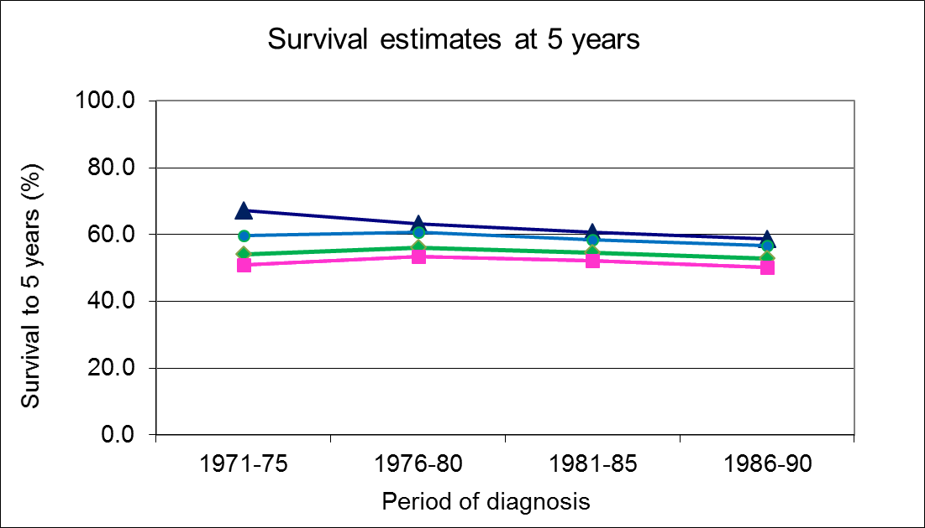

Example: Age-standardised cancer survival (salivary gland cancer)
Notes:
I’ll very quickly run through a practical example of age-standardisation. So we start with our overall unstandardised net survival statistics for different years (click click). We can see the trend here. Then we have these same statistics within different patient age-groups. Using our ICSS weights, we then calculate the contribution each age-group makes to the age-standardised survival, by multiplying the appropriate weight by the survival in that age group. Finally we add all these contributions up, to get our age-standardised survival. We can see from the results that our age-standardised survival is slower than crude survival, and some of the trends are different. Comparing this age-standardisation to other approaches, we find quite similar results for this example.

Slide 12
Calculation: age-standardised survival
Estimate age-specific survival for each age-group
Combine these estimates in a weighted average
Age-standardised survival (AS)
where
S_{i} = survival estimate for age group i
w_{i} = proportion of patients in age group i in the standard population
Sum weights: w1+w2+...wn=1
Notes:
Moving on to calculating age-standardised survival, here are the important steps. First, we group patients into bins based on age-groups they belong to, like 15-39, 40-49, 50-59, and calculate survival within each bin. We then combine these estimates into one single statistic using the following formula: it’s the survival in each bin S multiplied by the appropriate weight W all added up, and the summation symbol is a short hand way of representing this, saying we add all instances of S*w from S1w1 to SnWn. All the weights W add up to 1, so the statistic has the interpretation of being what the crude net survival would be in a hypothetical world where the survival of patients within each age-group is the same as actually is, but the population had different proportions of patients in each age-group – specified by the value of the w1. So for example, if S1 was the survival estimate for the youngest patient age-group and w1 was 0.3, then our survival estimate is equivalent to the estimate for a hypothetical population where 30% of the population was in the youngest age-group, with proportions of patients in other age-groups specified by w2 to w-n.

Slide 13
Calculation: standard error for age-standardised survival
where,
SE(S_{i})= standard error for the survival estimate in age group i
w_{i} = proportion of patients in age group i in the standard population
Notes:
The formula for the standard error of the age-standardised survival, which we can use to generate a confidence interval for it, is given here. We see that it is determined as the square root of each of the standard error of the survival in each strata squared, multiplied by its weight squared. So the relative weight given to each age-group in the age-standardised survival, also determines the relative weight given to its standard error when pooling the standard errors from each strata to generate the combined standard error, which makes sense. It means if in our standardisation we give great weight to a strata with low patient numbers, and hence large standard error, the age-standardised survival will have correspondingly higher standard error, and similar large weight to strata with low standard error means low standard error in the age-standardised survival too.

Slide 14
Calculation: 95% confidence interval for age standardised survival
Lower Limit
Upper limit
Based on a logarithmic transformation of the survival function
Notes:
Finally, here are the formulae for 95% confidence intervals for the age-standardised survival. We can use these and the age-standardised standard error when comparing populations, to see if differences between them are statistically significant. The confidence intervals are based on the assumption that the net survival estimates are log-normally distributed around their true value, an assumption which is reasonable for net survival estimates and which constrains the lower confidence limit to be positive.

Slide 15
Conclusions
When comparing net survival estimates between groups there is still a residual impact of patient age on the estimates.
This can be remedied by age-standardisation of the net survival estimates. Confidence intervals can be generated for age-standardised estimates, allowing comparisons between them.
The reference population can be chosen to maximise:
Comparability with other studies
Maximum agreement between un-standardised and standardised estimates
Computational ease
ICSS reference population is a very good choice for all these… though you may be required to use another one!
Notes:
So, to wrap up, even in the net survival framework there is still a residal effect of age on comparisons if there age differences between the populations compared. If we don’t want patient age differences affecting comparisons, standardisation allows us to control for this bias. We can then compare age-standardised survival, to see if it improves over time, to see which countries and regions perform best. We want to pick a reference population to maximise comparability with other studies, to have maximum agreement between un-standardised and standardised estimates, and which is easiest computationally... The ICSS is a good choice for all these.

Slide 16
References
Corazziari I, Quinn M, Capocaccia R. Standard cancer patient population for age standardising survival ratios. Eur J Cancer 2004;40:2307-2316.
Capocaccia R, Gatta G, Roazzi P, Carrani E, Santaquilani M, De Angelis R, Tavilla R, EUROCARE Working Group. The EUROCARE-3 database: methodology of data collection, standardisation, quality control and statistical analysis. Ann Oncol 2003; 14: v14-v27.
Sankaranarayanan, R.; Black, R. J. & Parkin, D. M. Cancer survival in developing countries (IARC Scientific Publications No. 145); 1998.
Ito Y, Ohno Y, Rachet B, Coleman MP, Tsukuma H, Oshima A. Cancer survival trends in Osaka, Japan: the influence of age and stage at diagnosis. Jpn J Clin Oncol 2007; 37: 452-458.
Quaresma, M, Coleman M, Rachet B. 40-year trends in an index of survival for all cancers combined and survival adjusted for age and sex for each cancer in England and Wales, 1971-2011: a population-based study. The Lancet 2015; 385: 1206-1218.
Notes:
Here are some references to the literature describing the different weights, and also two describing standardisation of cancer survival.
Thank you! Any questions??

Slide 17




Cancer Survival Analysis using Population-Based Data Granada, 27-28 March - 2017
Day 2 – Practical
Study designs
Improving health worldwide
http://csg.lshtm.ac.uk
@csg_lshtm

Slide 18
Learning objectives
To estimate net survival using cohort and period approach, and to compare the results.

Slide 19
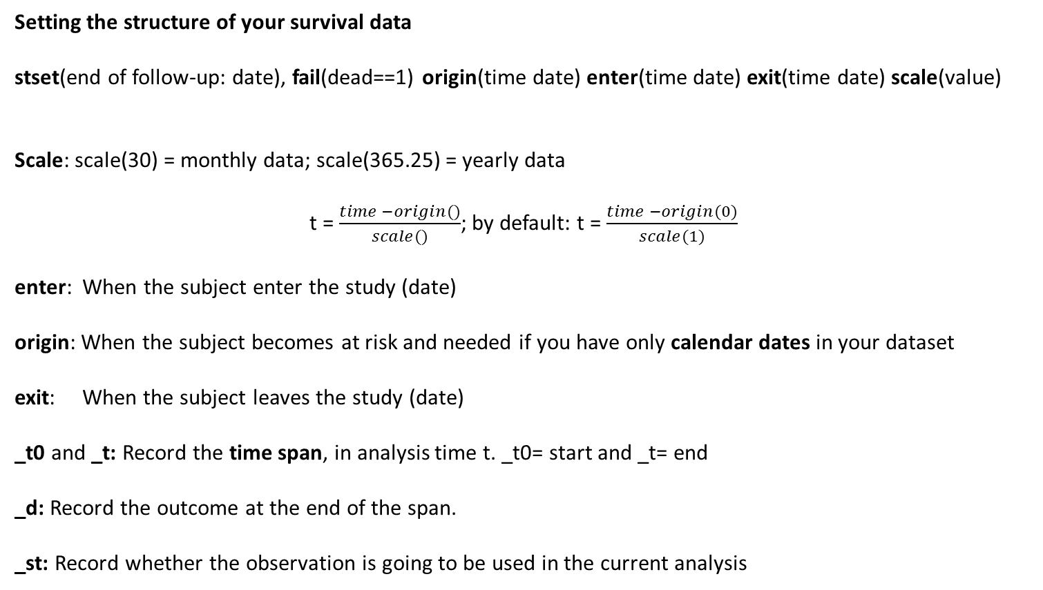
Stata: stset
Setting the structure of your survival data
stset(end of follow-up: date), fail(dead==1) origin(time date) enter(time date) exit(time date) scale(value)
Scale: scale(30) = monthly data; scale(365.25) = yearly data
t = $\frac{time −origin()}{scale()}$; by default: t = $\frac{time −origin(0)}{scale(1)}$
enter: When the subject enter the study (date)
origin: When the subject becomes at risk and needed if you have only calendar dates in your dataset
exit: When the subject leaves the study (date)
_t0 and _t: Record the time span, in analysis time t. _t0= start and _t= end
_d: Record the outcome at the end of the span.
_st: Record whether the observation is going to be used in the current analysis

Slide 20

Chapters
4, 5, 6

Slide 21
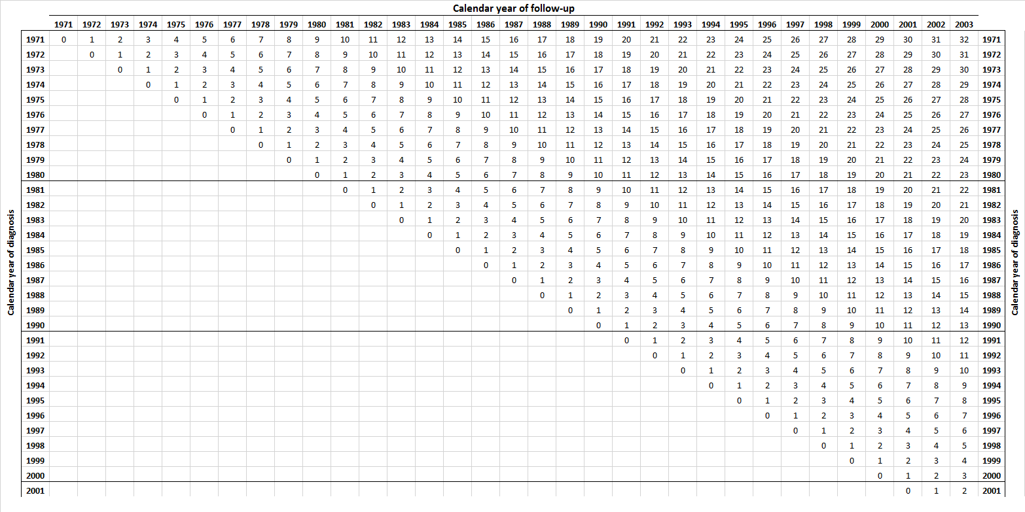
Breast_stns.dta

Slide 22
Breast_stns.dta

Slide 23
. stset finmdy, fail(dead==1) origin(time diagmdy) enter(time diagmdy)
failure event: dead == 1
obs. time interval: (origin, finmdy]
enter on or after: time diagmdy
exit on or before: failure
t for analysis: (time-origin)
origin: time diagmdy
------------------------------------------------------------------------------
355801 total observations
0 exclusions
------------------------------------------------------------------------------
355801 observations remaining, representing
212121 failures in single-record/single-failure data
920269050 total analysis time at risk and under observation
at risk from t = 0
earliest observed entry t = 0
last observed exit t = 12052

Slide 24
Stata: stset
stset finmdy, fail(dead==1) origin(time diagmdy) enter(time diagmdy) scale(365.25)
list diagmdy finmdy _t0 _t _d _st in 1/10
+----------------------------------------------------+
| diagmdy finmdy _t0 _t _d _st |
|----------------------------------------------------|
1. | 01jan2000 31dec2003 0 3.9972621 1 1 |
2. | 29jul1998 31dec2003 0 5.4236824 0 1 |
3. | 30jan1998 31dec2003 0 5.9164956 0 1 |
4. | 09jul1998 31dec2003 0 5.4784394 0 1 |
5. | 22dec1998 31dec2003 0 5.0239562 0 1 |
|----------------------------------------------------|
6. | 23jan1998 31dec2003 0 5.9356605 0 1 |
7. | 16jul1998 31dec2003 0 5.4592745 0 1 |
8. | 07jul1999 31dec2003 0 4.4845996 0 1 |
9. | 18aug1998 31dec2003 0 5.3689254 0 1 |
10. | 01sep1999 01oct2003 0 4.0821355 1 1 |
+----------------------------------------------------+

Slide 25
Net Survival Estimates
Hypothetical Scenario:
9 Cohorts from 1971 to 1979
5 incident cases per year
Recursive survival pattern:
1 individual survives 15 years
1 individual survives 10 years
1 individual survives 7 years
1 individual survives 4 years
1 individual survives 2 years
Several options to estimate Net Survival answering different questions:
The complete data (considering the last update date)
From one particular cohort
From one or several aggregated calendar periods

Slide 26
71
72
73
74
75
76
77
78
79
71
72
73
74
75
76
77
78
79

Slide 27
Q1: Cohort and Period

Slide 28
Cohort approach, 1971
*cohort approach 1971
stset finmdy, fail(dead==1) origin(time diagmdy) enter(time diagmdy) scale(365.25)
stns list using lifetable_stns.dta if year(diagmdy)==1971, ///
age(agediagindays=_age) period(diagmdy=yearindays) ///
strata(sex dep) rate(rate_day) ///
at(.5 1 5 10 15, scalefactor(365.25) unit(year)) ///
saving(cohort_1971, replace)
type of estimate: kaplan-meier
failure _d: dead == 1
analysis time _t: (finmdy-origin)
origin: time diagmdy
enter on or after: time diagmdy
Time Event Beg. Net Net Surv.
(year) Time Total Fail Lost Function [95% Conf. Int.]
---------------------------------------------------------------------------------------
.5 182 6061 838 0 0.8722 0.8634 0.8810
1 365 5223 480 1 0.8013 0.7906 0.8120
5 1826 4742 2056 7 0.4992 0.4844 0.5139
10 3646 2679 1024 1 0.3485 0.3306 0.3664
15 5467 1654 474 3 0.3126 0.2907 0.3345
---------------------------------------------------------------------------------------

Slide 29
Cohort, 1971
The survival of women diagnosed in 1971, as computed with the cohort approach, was:
one-year survival: 0.80 (95% CI 0.79-0.81)
five-year survival: 0.50 (95% CI 0.48-0.51)
ten-year survival: 0.35 (95% CI 0.33-0.37)
fifteen-year survival: 0.31 (95% CI 0.31-0.33)

Slide 30
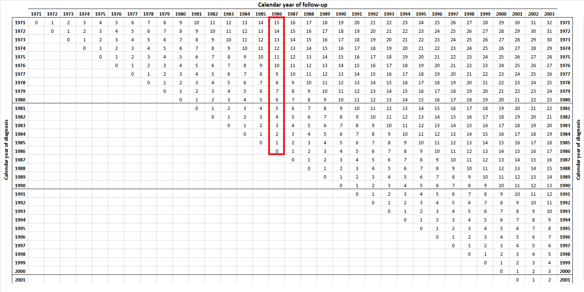
Period approach, 1986
JUSTIFICATION:
Need of UPDATED SURVIVAL estimates that account for recent improvements in treatment
All observations included in the analysis are LEFT TRUNCATED and RIGHT CENSORED at 1986
Then from the survivors of the cohort of 1971 we will have 15 years of follow-up (5480 days)
STNS account for the informative censoring
(cancer deaths that occurs during the first years following diagnosis)

Slide 31
Period approach, 1986
Pohar-Perme estimate:
Needs to account for
Informative censoring
from the date of diagnosis
*Period approach 1986
stset finmdy, fail(dead==1) origin(time diagmdy) ///
enter(time mdy(1, 1, 1986)) exit(time mdy(12, 31, 1986))
stns list using lifetable_stns.dta, ///
age(agediagindays=_age) period(diagmdy=yearindays) ///
begintime(origin) strata(sex dep) rate(rate_day) ///
at(.5 1 5 10 15, scalefactor(365.25) unit(year)) end_followup(5480) ///
saving(period_1986, replace)
15 years

Slide 32
Period approach, 1986
The PERIOD approach corresponds to the survival which would be observed amongst
NEWLY DIAGNOSED patients if the currently observed conditional survival probabilities
were to remain constant.

Slide 33
Period approach, 1986
In 1986, the predicted survival for women with breast cancer, obtained through period analysis:
one-year survival: 0.88 (95% CI 0.87-0.88)
five-year survival: 0.63 (95% CI 0.62-0.64)
ten-year survival: 0.48 (95% CI 0.46-0.50)
fifteen-year survival: 0.41 (95% CI 0.39-0.44)
In situations where SURVIVAL is improving over time the PERIOD approach will always be lower than the corresponding cohort estimate.
ADVANTAGE:
It can estimate the NET SURIVAL for the cohort 1986 SEVERAL YEARS EARLIER.

Slide 34
Period approach, 1986
The survival of women diagnosed in 1971, as computed with the cohort approach, was:
one-year survival: 0.80 (95% CI 0.79-0.81)
five-year survival: 0.50 (95% CI 0.48-0.51)
ten-year survival: 0.35 (95% CI 0.33-0.37)
fifteen-year survival: 0.31 (95% CI 0.31-0.33)
In 1986, the predicted survival for women with breast cancer, obtained through period analysis:
one-year survival: 0.88 (95% CI 0.87-0.88)
five-year survival: 0.63 (95% CI 0.62-0.64)
ten-year survival: 0.48 (95% CI 0.46-0.50)
fifteen-year survival: 0.41 (95% CI 0.39-0.44)

Slide 35
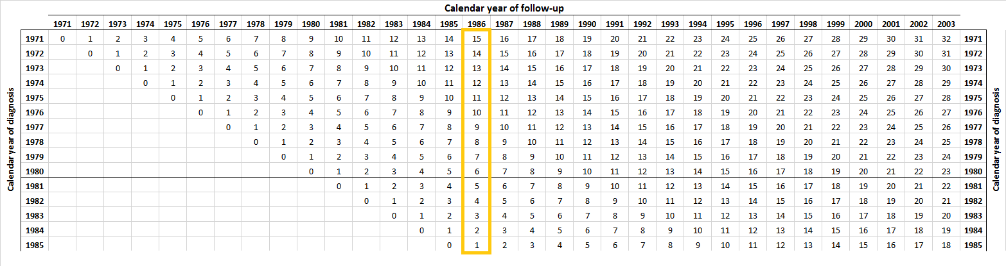
Period approach 1986
Cohort 85
Biased: we do not have INCIDENT cases for the YEAR 1986

Slide 36
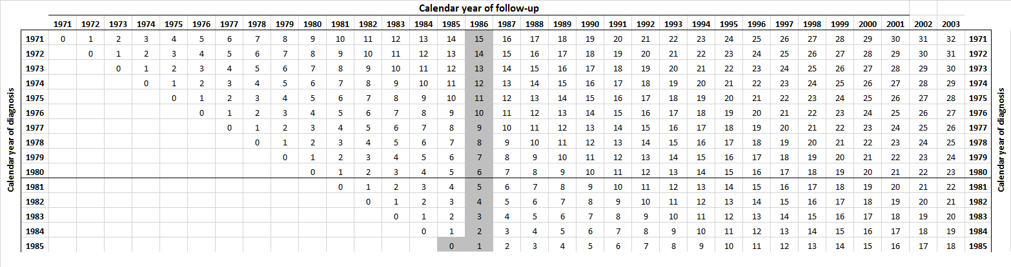
Hybrid approach: 1986
Hybrid 1986
gen entermdy = cond(diagmdy>=mdy(1, 1, 1985), diagmdy, mdy(1, 1, 1986))
stset finmdy, fail(dead==1) origin(time diagmdy) enter(time entermdy) ///
exit(time mdy(12, 31, 1986))
stns list using lifetable_stns.dta, ///
age(agediagindays=_age) period(diagmdy=yearindays) ///
begintime(origin) strata(sex dep) rate(rate_day) end_followup(5480) ///
at(.5 1 5 10 15, scalefactor(365.25) unit(year)) ///
saving(hybrid_1986, replace)
Cohort 85

Slide 37
Hybrid approach: 1986
Hybrid 1986
If date of diagnosis >=1985 (then) ➔ 1985
else date of diagnosis <1985 (then) ➔ 1,1,1986
Combined information:
Cohort 1985 + most updated information for other cohorts (the most recent year).
stset finmdy, fail(dead==1) origin(time diagmdy) ///
enter(time entermdy) exit(time mdy(12, 31, 1986))

Slide 38
Hybrid approach: 1986
The ‘biased’ period estimates using the modified dataset were:
one-year survival: 0.84 (95% CI 0.80-0.87)
five-year survival: 0.60 (95% CI 0.57-0.63)
ten-year survival: 0.46 (95% CI 0.43-0.48)
fifteen-year survival: 0.39 (95% CI 0.36-0.42)
The estimates obtained with hybrid analysis were:
one-year survival: 0.88 (95% CI 0.88-0.89)
five-year survival: 0.63 (95% CI 0.62-0.64)
ten-year survival: 0.48 (95% CI 0.47-0.50)
fifteen-year survival: 0.41 (95% CI 0.39-0.44)

Slide 39
References and further reading
Brenner H, Gefeller O. An alternative approach to monitoring cancer patient survival. Cancer 1996; 78: 2004-2010.
Brenner H, Gefeller O, Hakulinen T. Period analysis for up-to-date cancer survival data. Theory, empirical evaluation, computational realisation and applications. Eur J Cancer 2004; 40: 326-335.
Brenner H, Hakulinen T. Advanced detection of time trends in long-term cancer patient survival: experience from 50 years of cancer registration in Finland. Am J Epidemiol 2002, 156(6): 566-577.
Brenner H, Hakulinen T. Very-long-term survival rates of patients with cancer. J Clin Oncol 2002; 20(21): 4405-4409.
Brenner H, Rachet B. Hybrid analysis for up-to-date long-term survival rates in cancer registries with delayed recording of incident cases. Eur J Cancer 2004; 40: 2494-2501.
Woods LM, Rachet B, Cooper N, Coleman MP. Predicted trends in long-term breast cancer survival for women diagnosed in England and Wales during the period 1971-2001 and followed up to 2003. Br J Cancer 2007; 96: 1135-1138.
Walters S, Benitez-Majano S, Muller P, Coleman MP, Allemani C, Butler J, Peake M, Guren MG, Glimelius B, Bergström S, Påhlman L. Is England closing the international gap in cancer survival?. Br J Cancer 2015; 113(5): 848-860.
Henderson R, Jones M, Stare J. Accuracy of point predictions in survival analysis. Stat Med 2001; 20: 3083-3096.

